Slide 1

Team4 Fuzzing Results
Team 3 : 100% Certified

Slide 2
Tool: ZZUF
•Execution
$ zzuf -s 0:100 -q -C 0 ./LgFaceRecDemoTCP_Jetson_NanoV2 ./friends640x480.mp4
•Result
– Observed these issues
$ zzuf[s=17,r=0.004]: signal 11 (SIGSEGV)
$ zzuf[s=56,r=0.004]: signal 11 (SIGSEGV)
$ zzuf[s=75,r=0.004]: signal 11 (SIGSEGV)
$ zzuf[s=77,r=0.004]: signal 11 (SIGSEGV)
$ zzuf[s=91,r=0.004]: signal 11 (SIGSEGV)

Slide 3
Tool: AFL
Chosen based on higher code coverage, widely used and freely available.
Tried in both instrumented mode and non-instrumented mode.
Environment setup took around 1 day time with the Jetson nano.
Instrumented mode
Recompiled the source code with AFL generated CC and CXX compilers afl-clang-fast and afl-clang-fast++, respectively.
Solved compile time errors and set the environment variables to start the execution.
But faced OOM fault errors, tried passing maximum available memory but not able to proceed, and error continues.

Slide 4
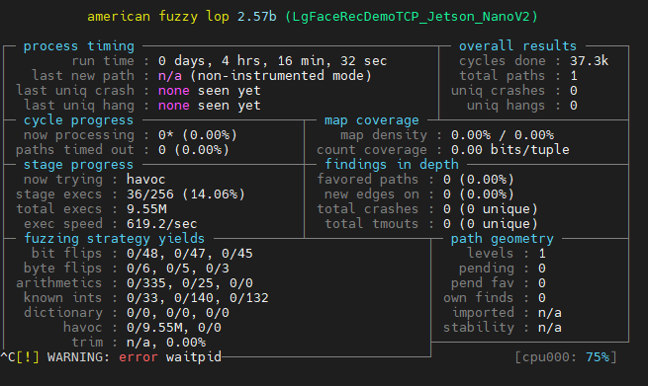
Tool: AFL
Non-instrumented mode
Used existing binaries no need to recompile, change the command line option for afl-fuzz
Able to execute and does not faced OOM issue.
We kept it running for 5-6 hours does, but complete execution needs too much time.
Faced difficult to keep it running for a long time on Jetson nano device.

